Slide 1
Retrieving Roads from Aerial Imagery
MUSA Capstone Project Final Presentation
Jiamin Tan
04/22/2022

Slide 2
Object
Use neural networks to segment roads from aerial images.

Slide 3

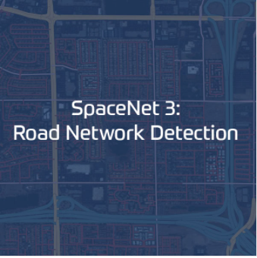
Data Source
https://spacenet.ai/

Slide 4
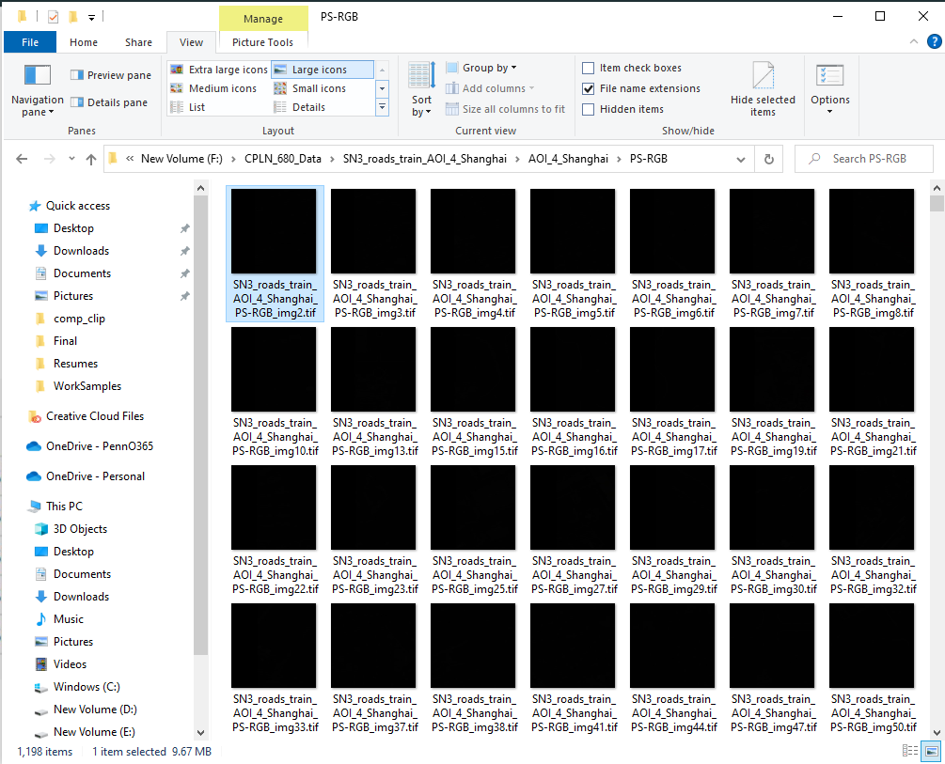
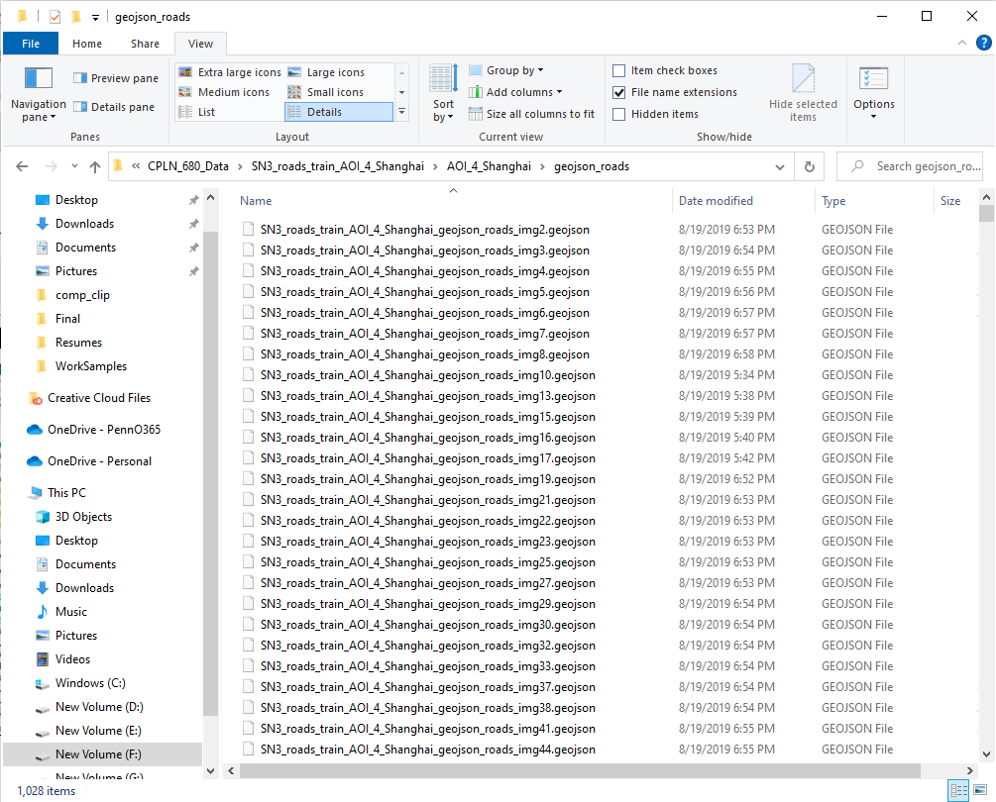
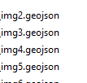
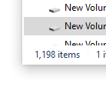
Data Overview
Training Image Set
.tif files stored satellite images.
Labels
.geojson files stored strings (roads) as
ground truth.
attributes such as type and number of lanes are included in the .geojson file.

Slide 5
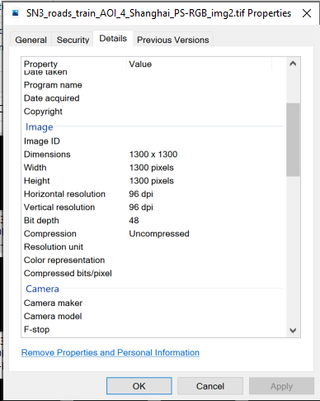
Data Overview
Training Image Set
For each pan-sharpened Image:
1300 x 1300 pixels.
Each pixel has a spatial resolution of
0.31m x 0.31m.
Each tile is, therefore, 400m x 400m.
Bit depth is 48, so 16 bit for each band, and the value of a pixel in each band is from 0 to 65535.

Slide 6
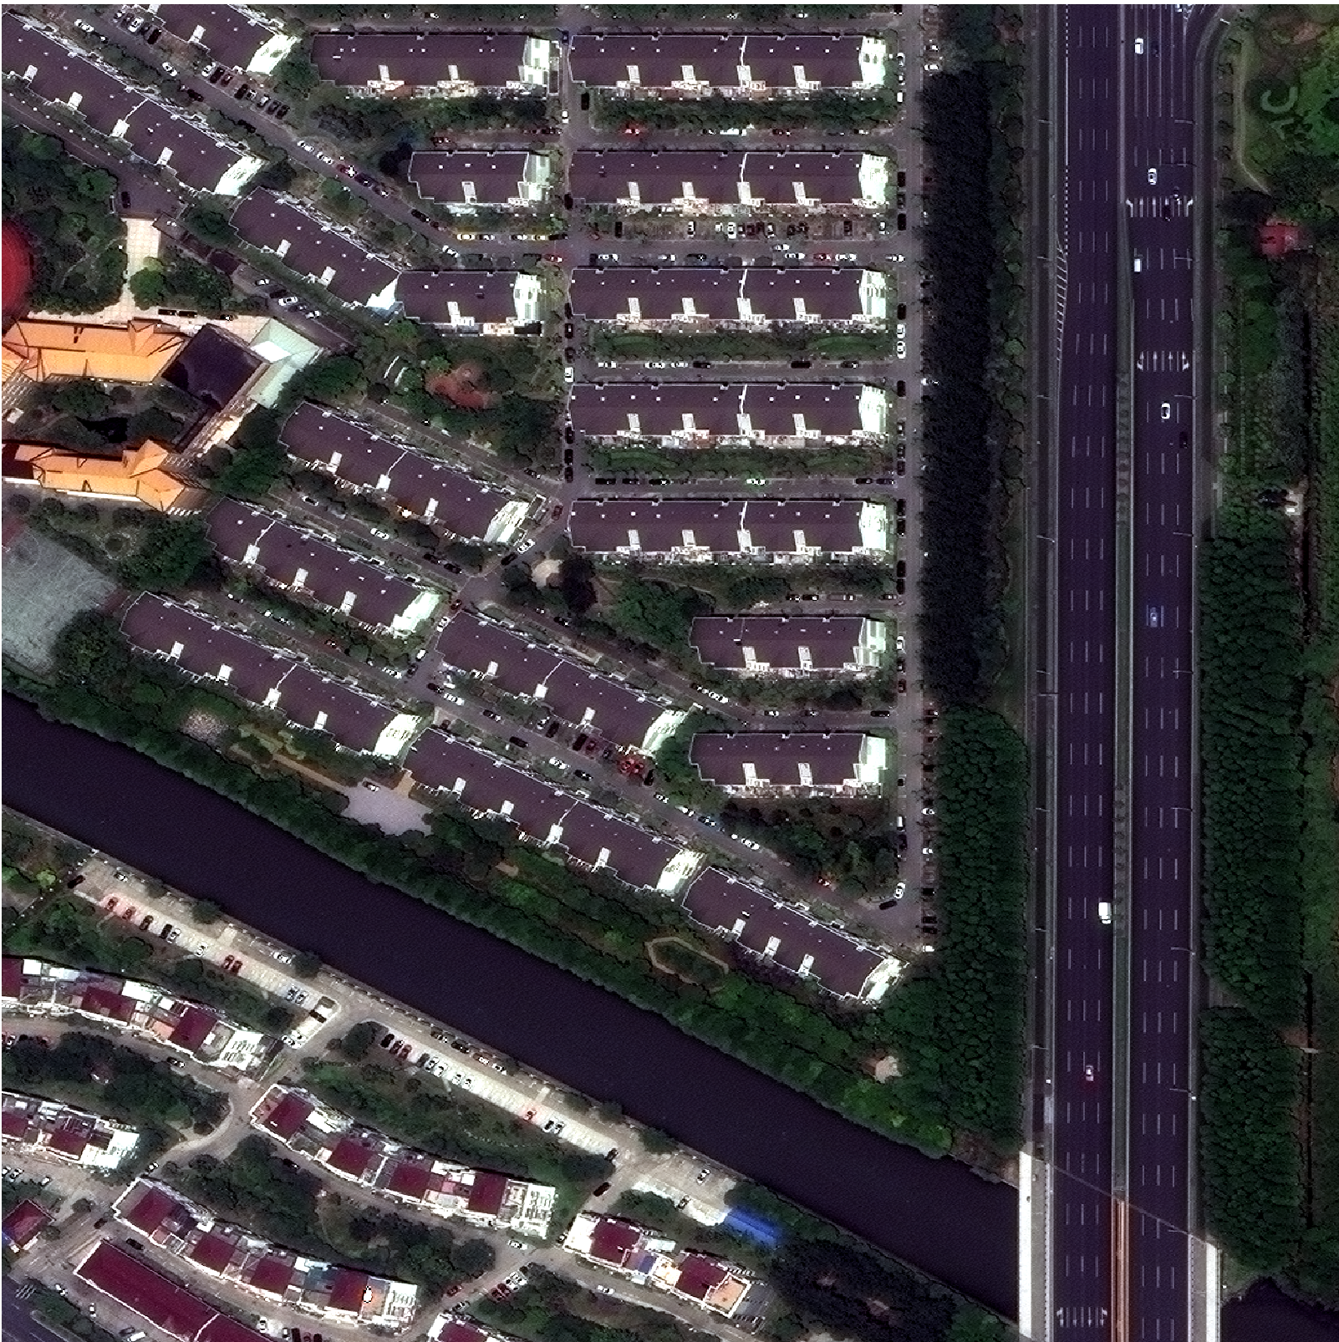
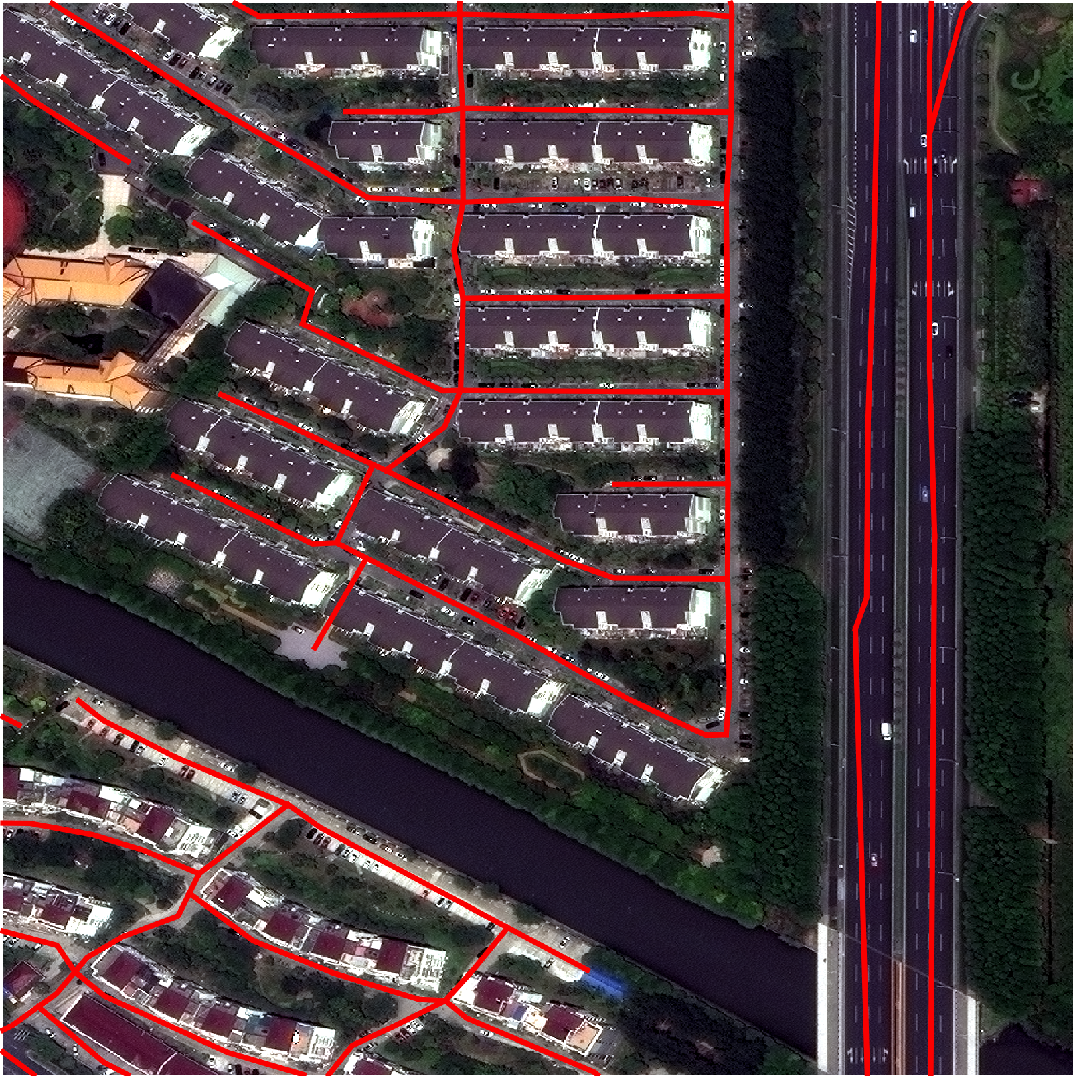
Data Overview (Examples)
Image 73
Image 73 and its label

Slide 7
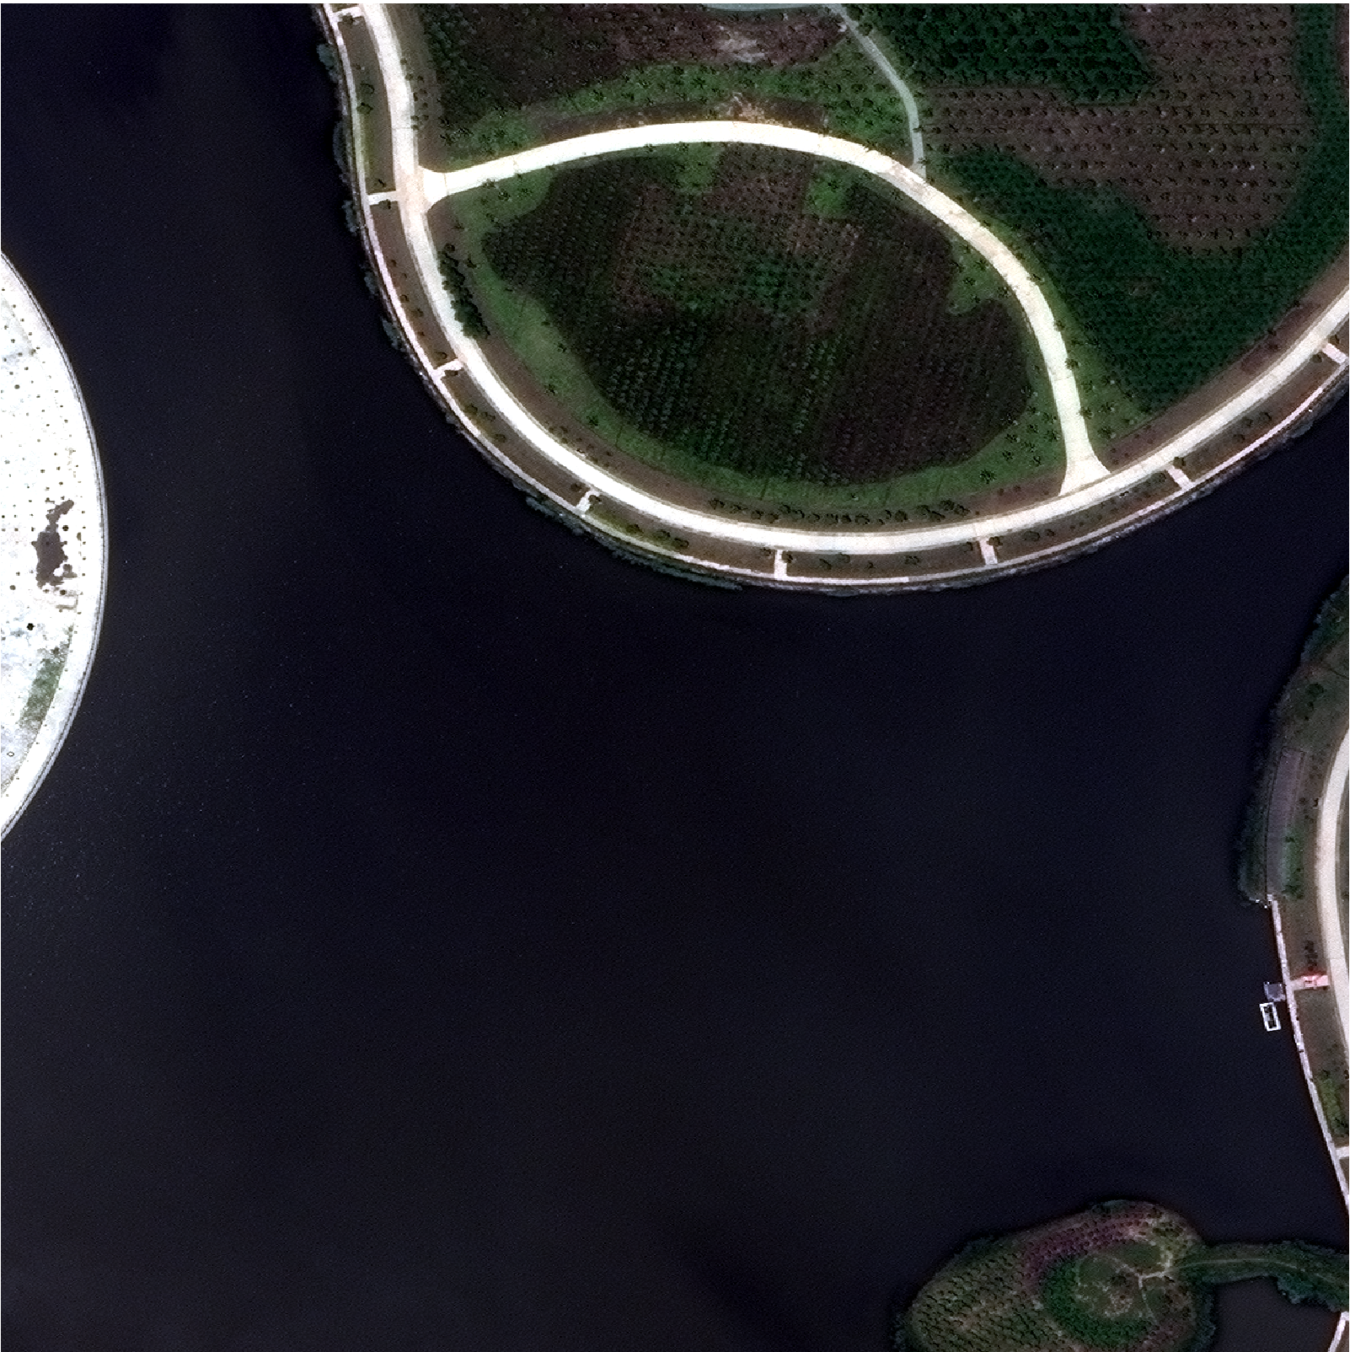
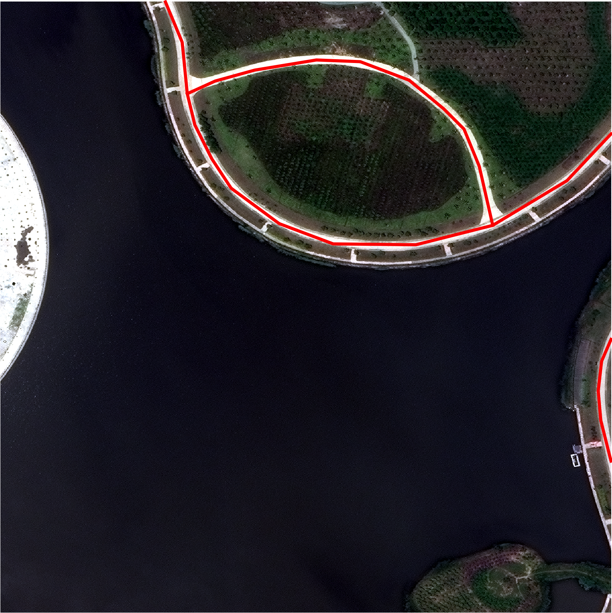
Data Overview (Examples)
Image 52
Image 52 and its label

Slide 8
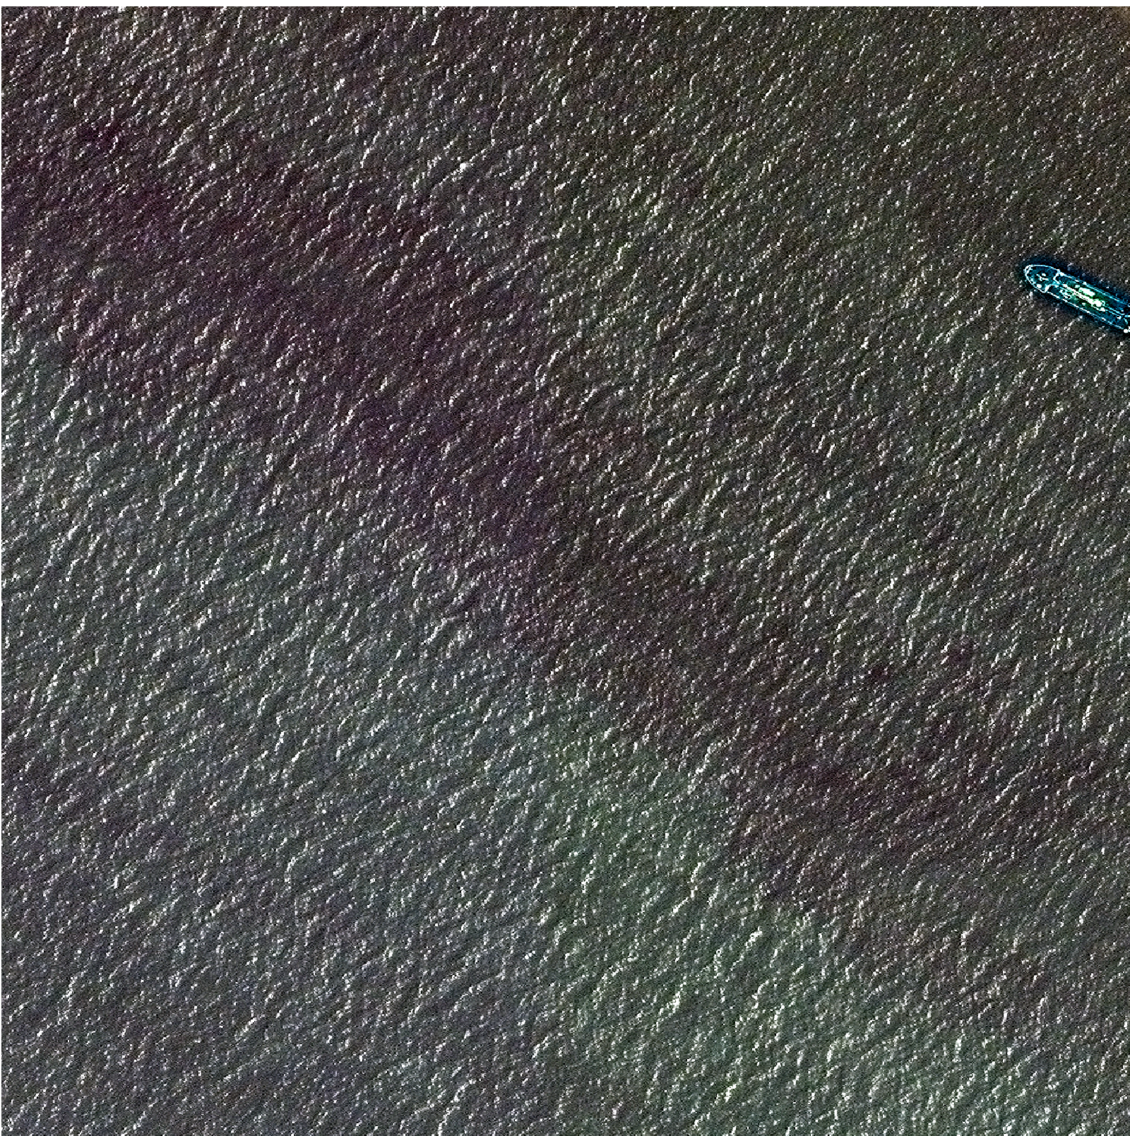
Data Overview (Examples)
Image 432
Image 432
does not have a label

Slide 9
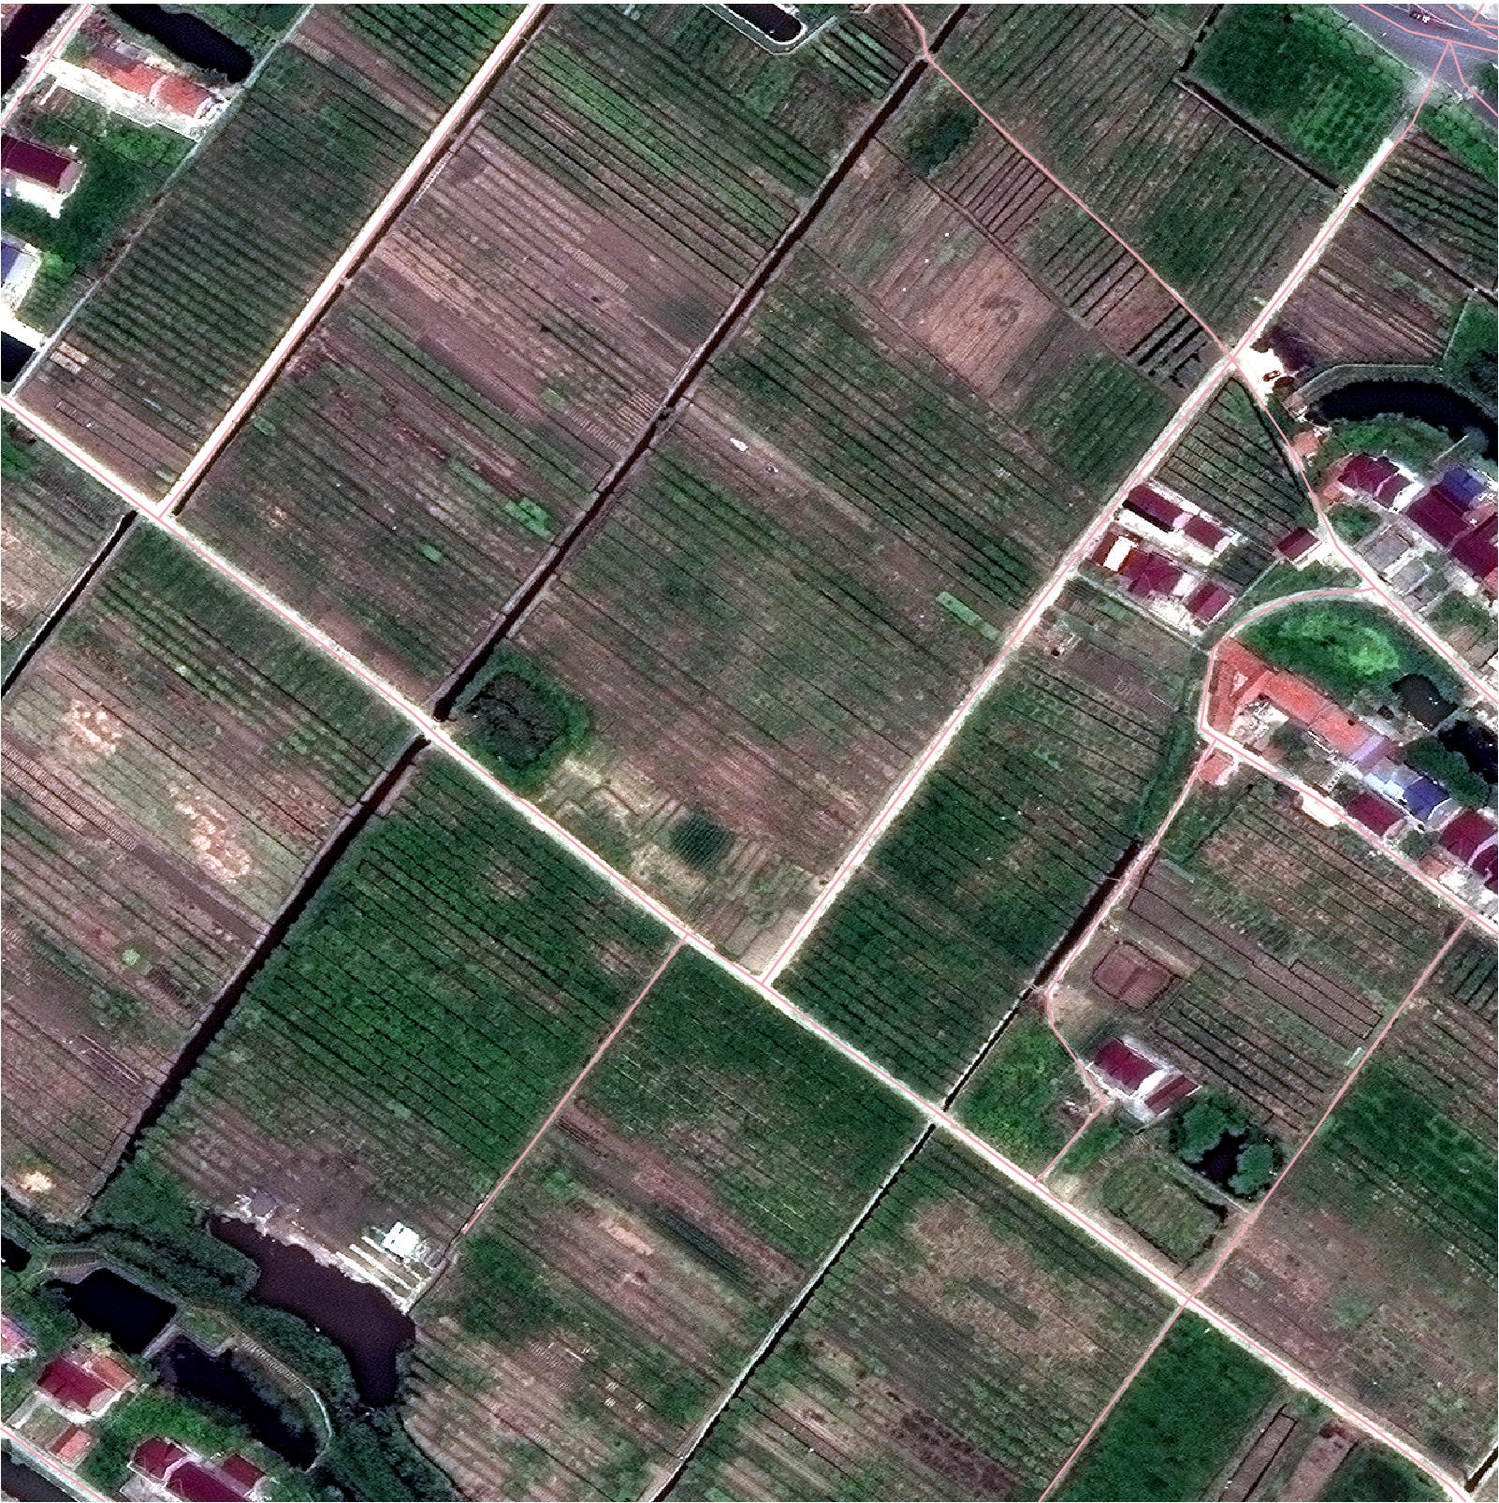
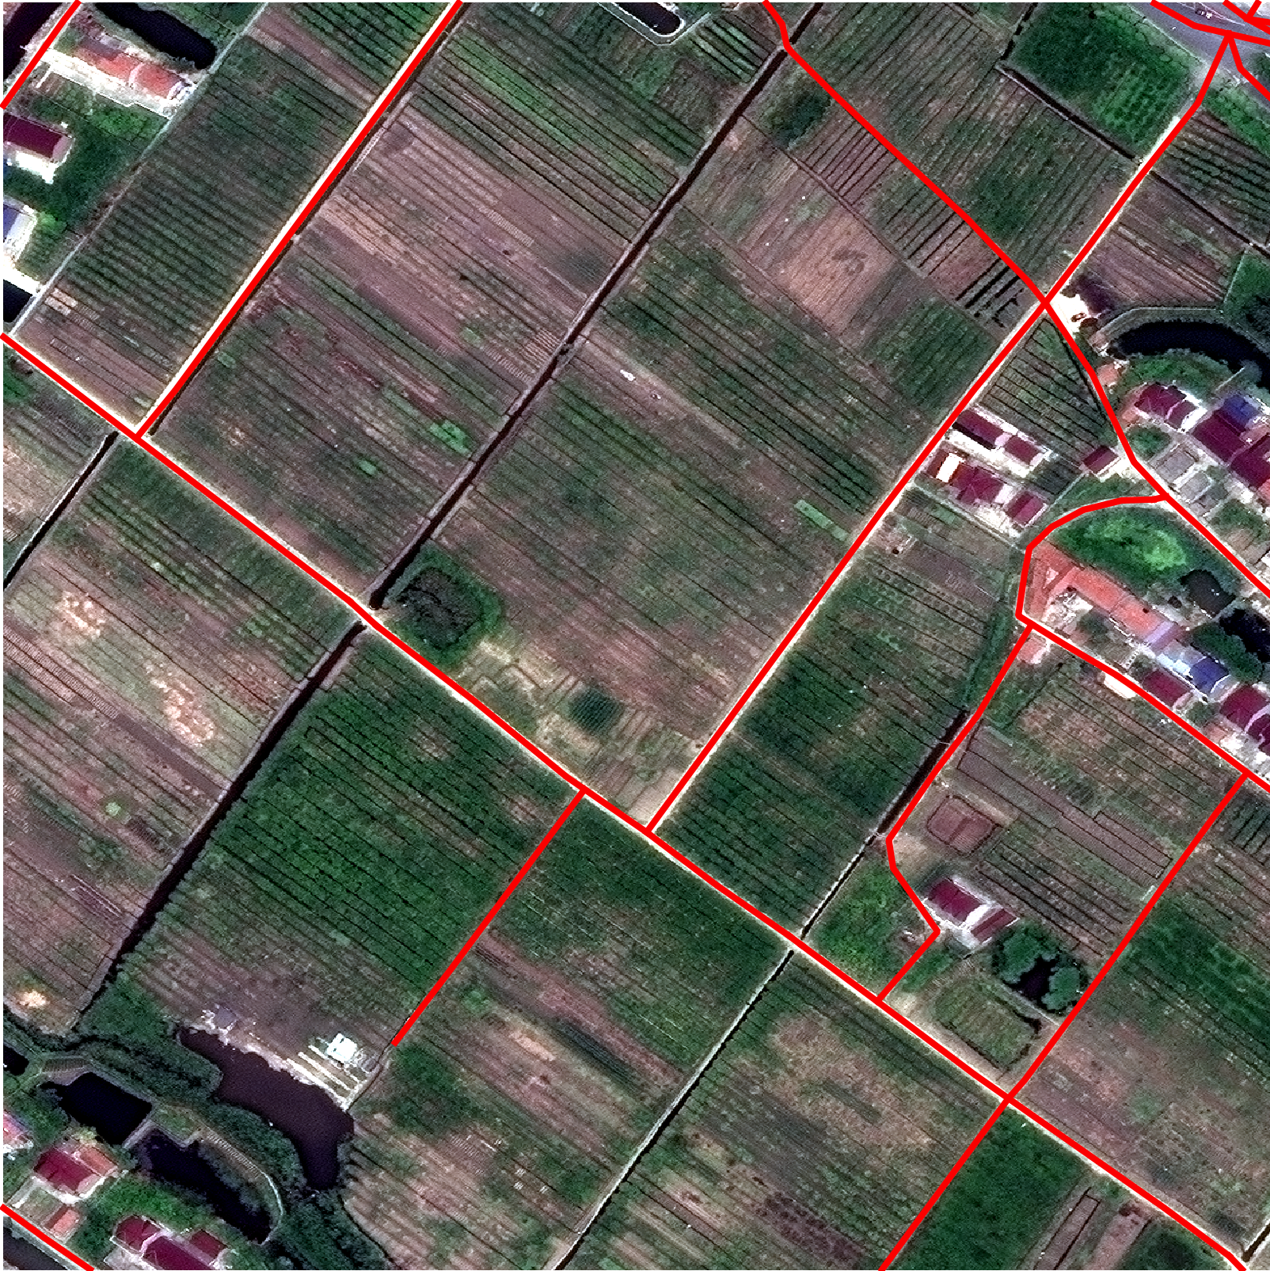
Data Overview (Examples)
Image 435
Image 435 and its label

Slide 10
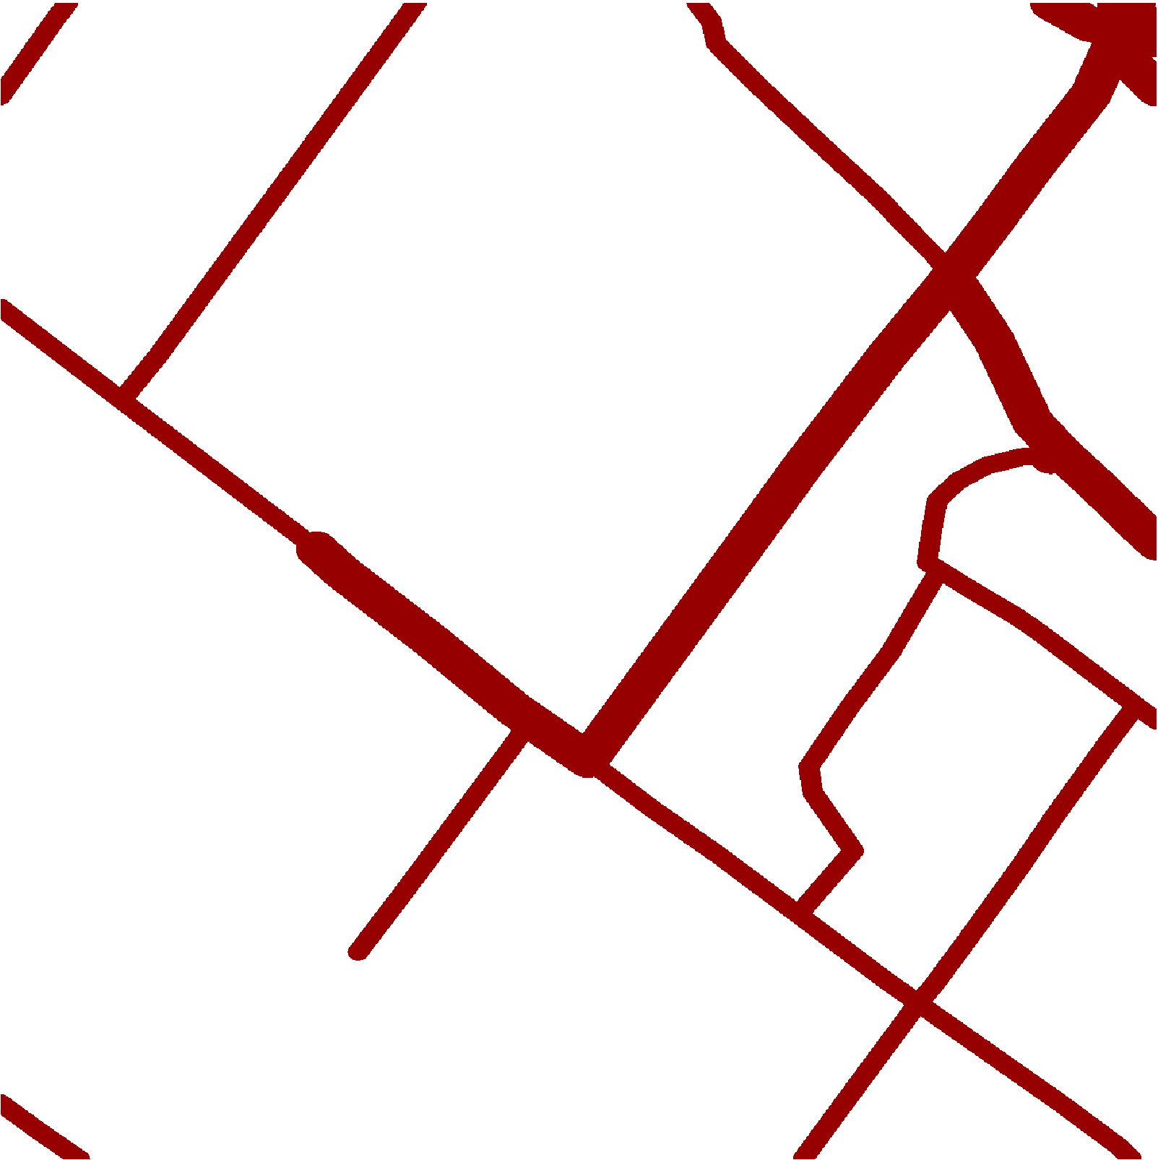
Preparation – Create Mask
A binary mask is generated for every image.
The mask is created by buffering the strings using GeoPandas.
The distance of the buffer is calculated by
3 meters x the number of lanes
Road types are not considered because 50% of the data were labeled as “unclassified” which do not have uniformed lane widths.
binary mask created for Image 435

Slide 11
Preparation – Create Mask (Example)
Image 435 and its label
binary mask created for Image 435

Slide 12
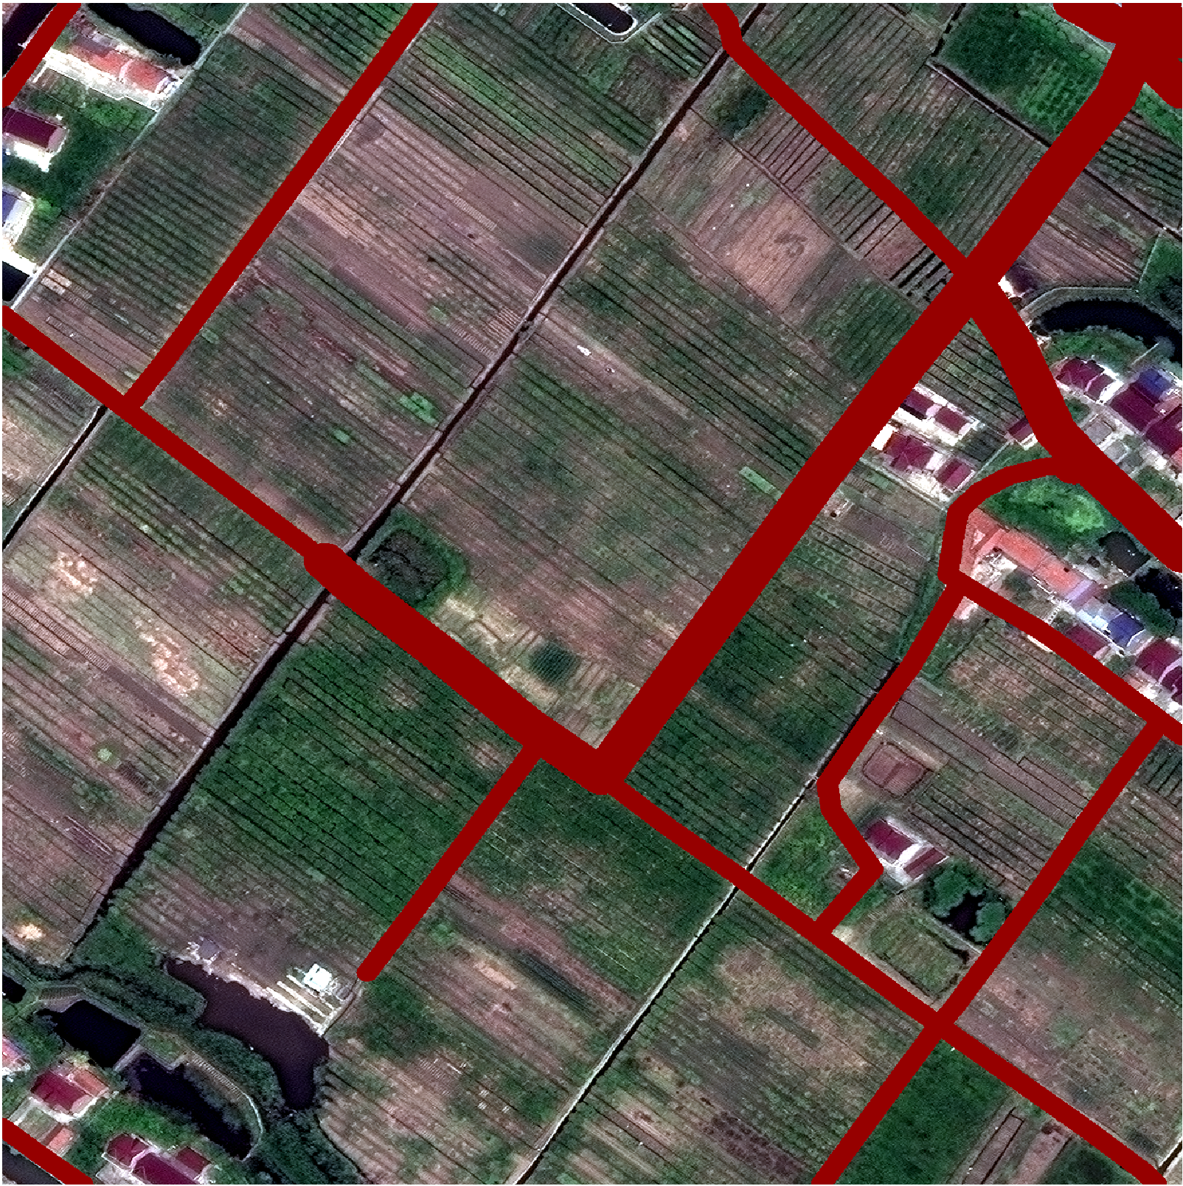
Preparation – Create Mask (Example)
Image 435 and its label
Image 435 and its binary mask

Slide 13
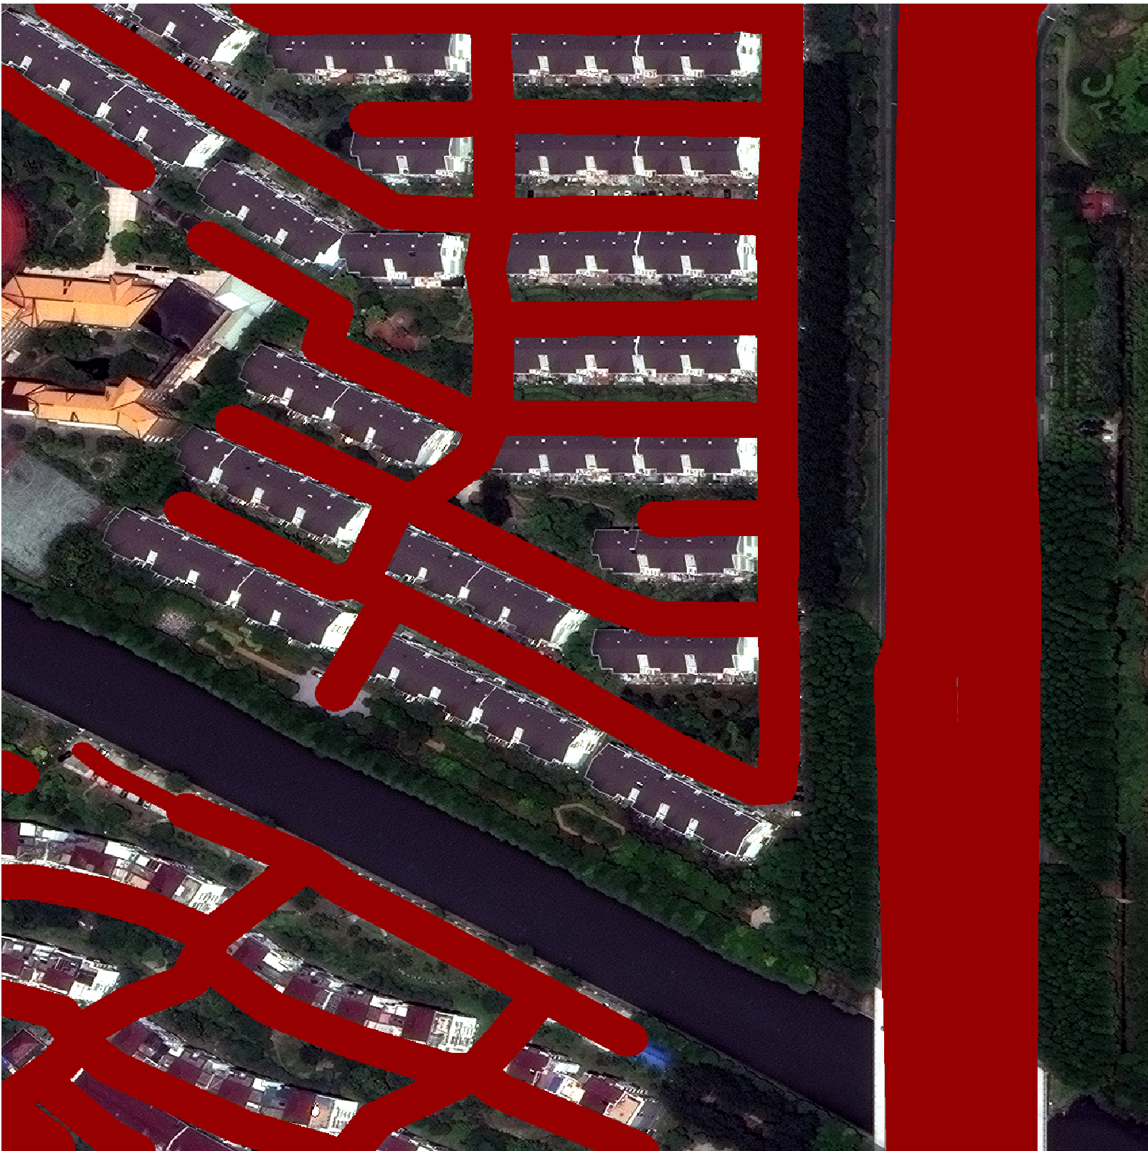
Preparation – Create Mask (Example)
Image 73 and its label
Image 73 and its binary mask

Slide 14
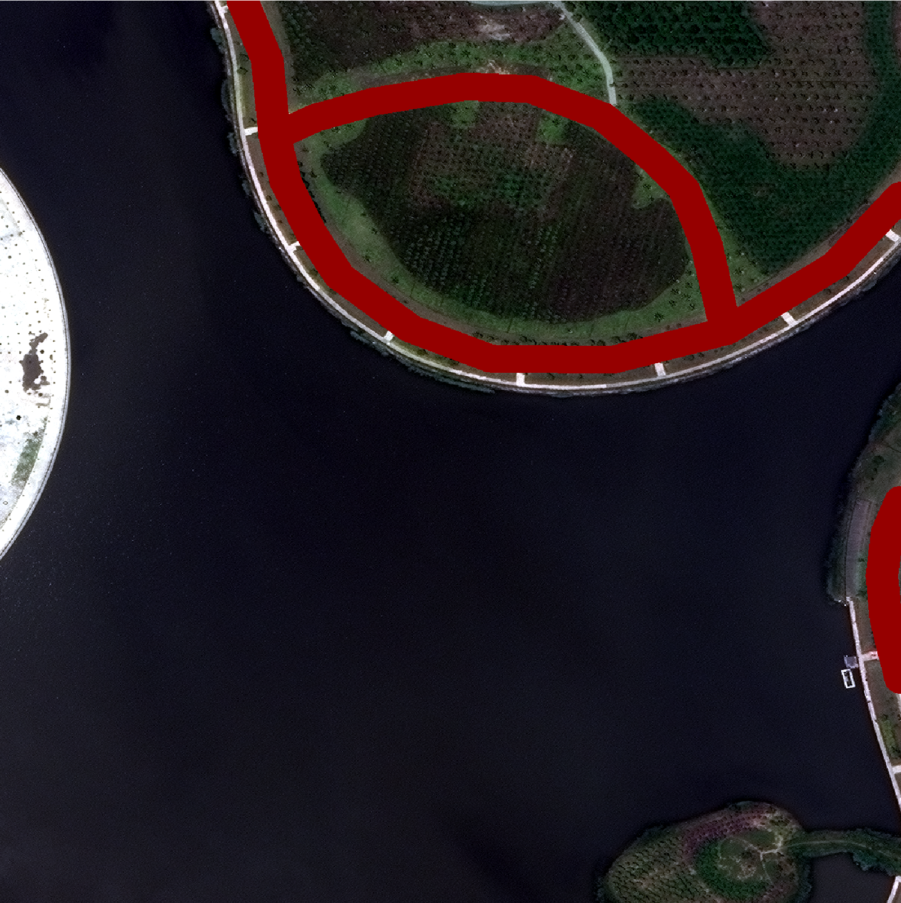
Preparation – Create Mask (Example)
Image 52 and its label
Image 52 and its binary mask

Slide 15
Preparation – Create Mask (Example)
Image 432
binary mask created for Image 432

Slide 16
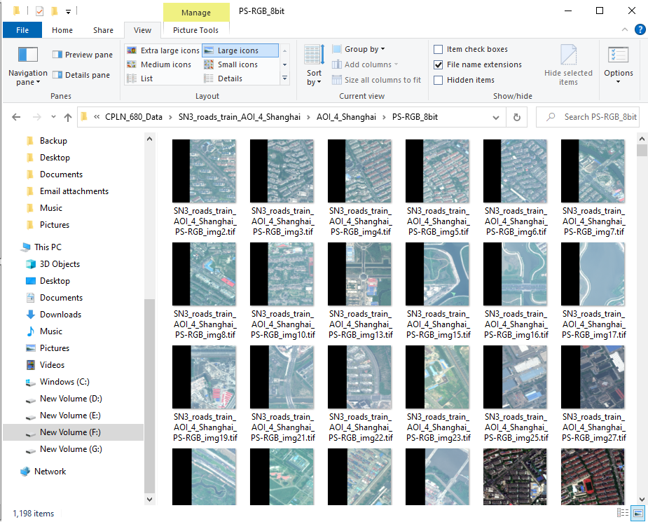
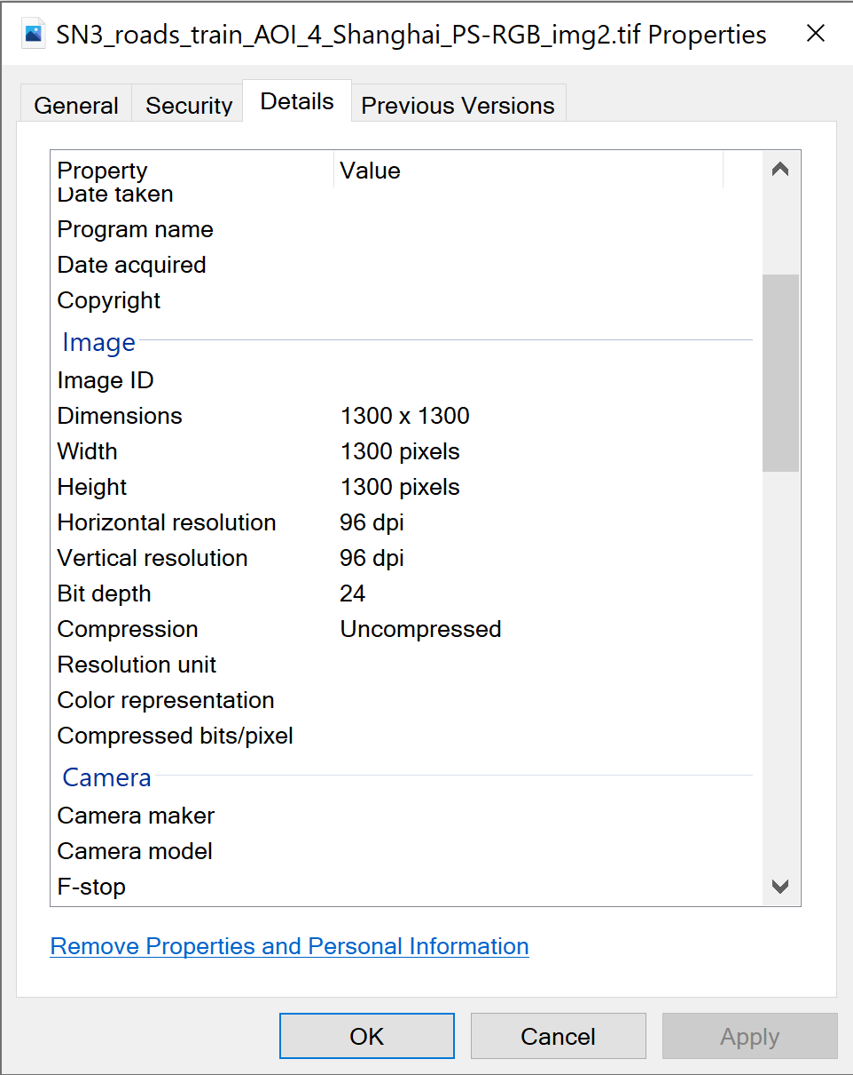
Preparation – Bit Depth Conversion
Training Image Set (8-bit)
48 bit-depth -> 24 bit-depth
8 bit for each band – value of a pixel in each band is from 0 to 255.
Resolution and dimension remain the same.

Slide 17
Preparation – Training/Test Set Split
The 1198 8-bit images and their binary masks are split into…
A training set with 1070 images (90%)
A validation set with 59 images (5%)
A test set with 61 images (5%)

Slide 18

Architecture – U-Net by Ronneberger et al. (2015)
https://lmb.informatik.uni-freiburg.de/Publications/2015/RFB15a/

Slide 19
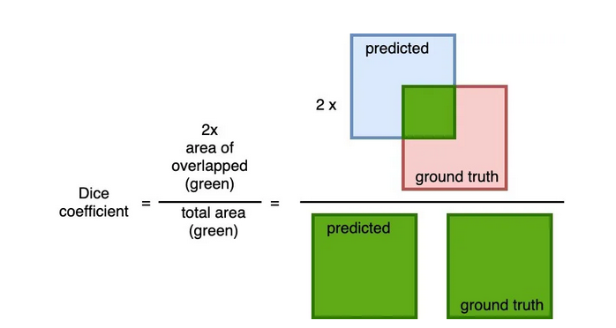
Model 1 – “Vanilla” U-Net
Using the same amount of convolutional and max-pooling layers in the original U-Net
Resize each image from (1300, 1300, 3) to (1024, 1024, 3)
Batch size = 2, epoch = 12, learning rate = 0.0001, optimizer = adam
Loss function: dice loss
https://datascience.stackexchange.com/questions/75708/neural-network-probability-output-and-loss-function-example-dice-loss

Slide 20
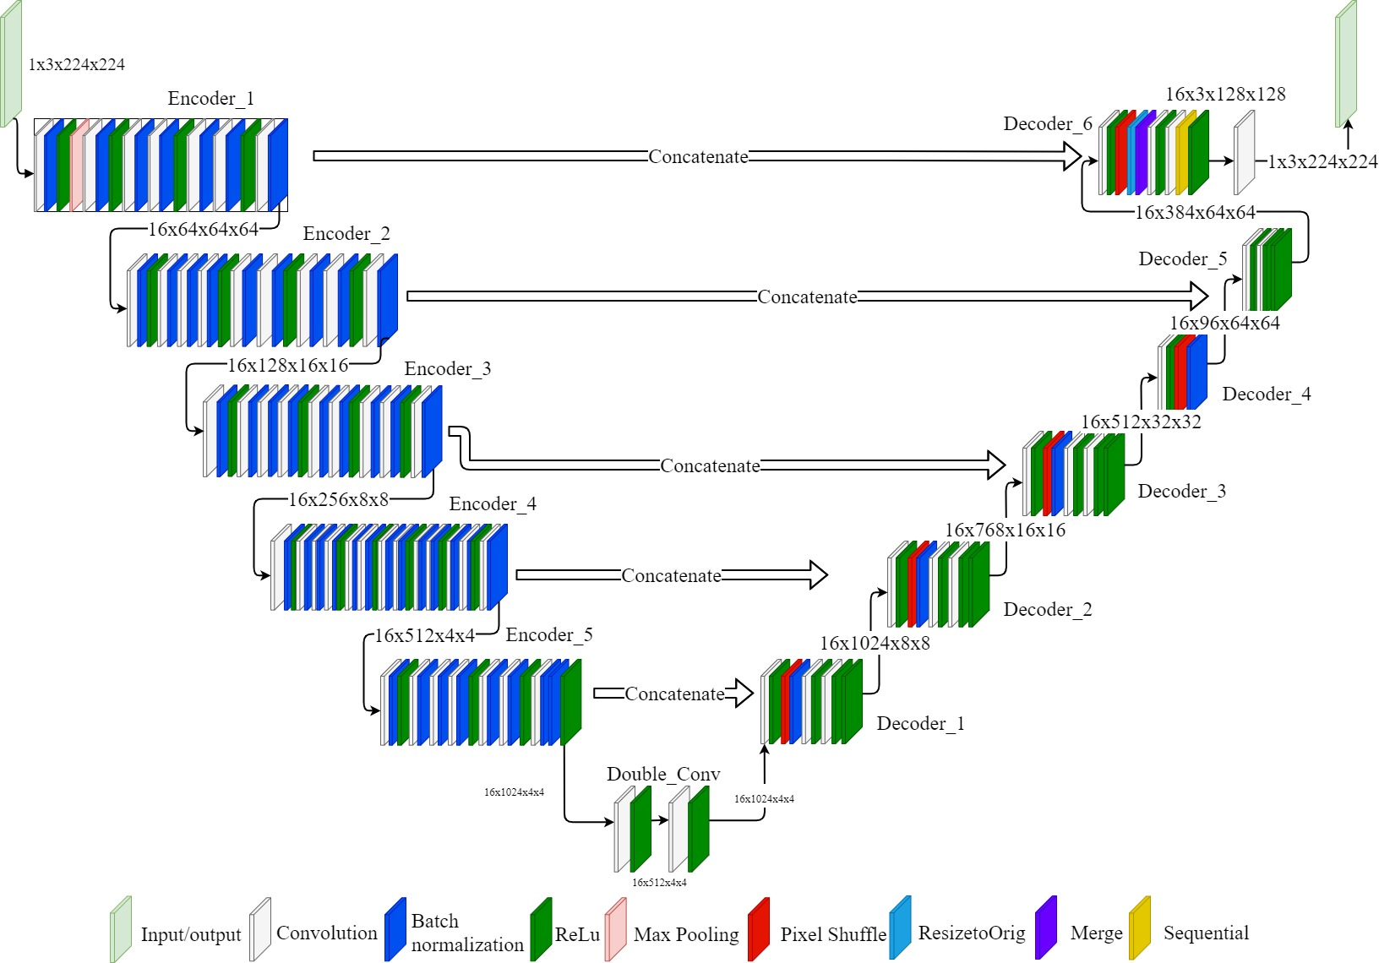
Model 2 – U-Net using Pre-trained ResNet50
For the encoding path, using a ResNet50 architecture pre-trained on “ImageNet”
Resize each image from (1300, 1300, 3) to (512, 512, 3)
Batch size = 2, epoch = 12, learning rate = 0.0001, optimizer = adam
Loss function: dice loss
https://forums.fast.ai/t/u-net-with-resnet34-backbone/85744

Slide 21
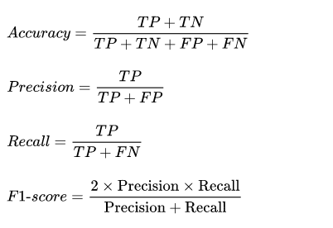
Results – F1 Score
A F1 score was calculated on predictions generated by the test set.
F1 score is a harmonic mean of precision and recall. It is a metric used for imbalanced data.
F1 score after fitting Model 1
0.6685
F1 score after fitting Model 2
0.6569
https://www.tutorialexample.com/an-introduction-to-accuracy-precision-recall-f1-score-in-machine-learning-machine-learning-tutorial/

Slide 22
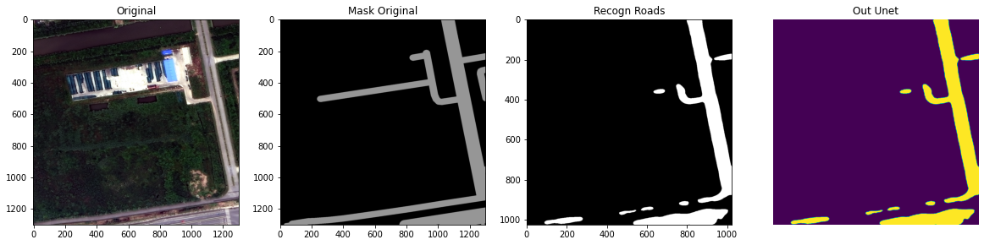
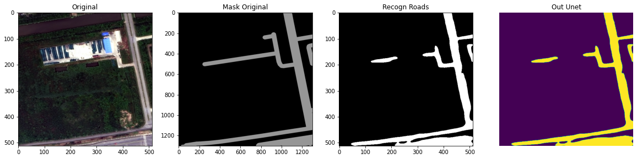
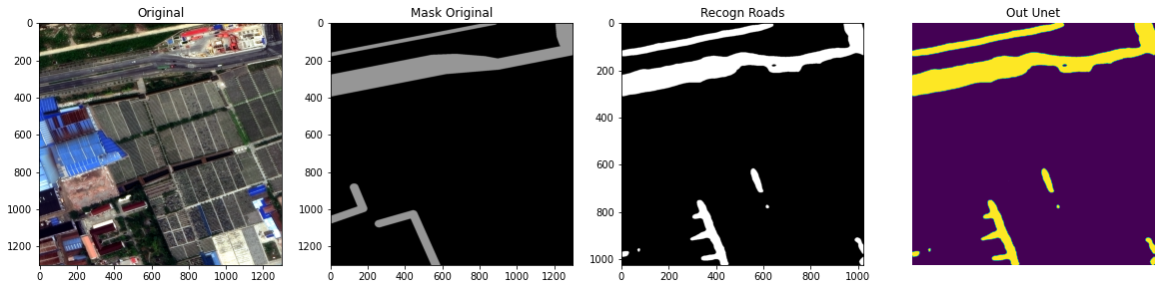
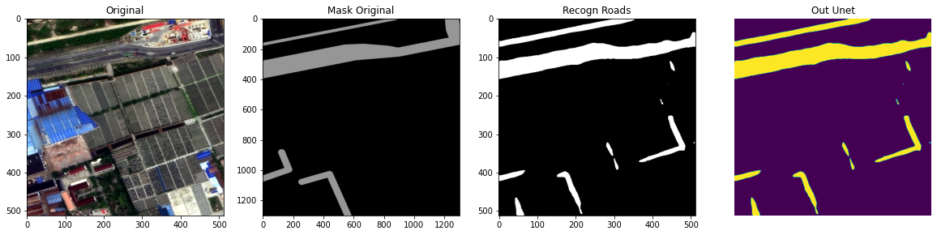
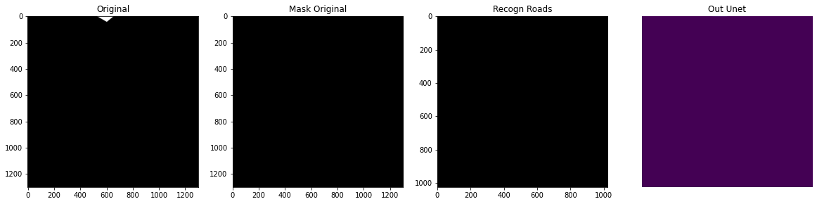
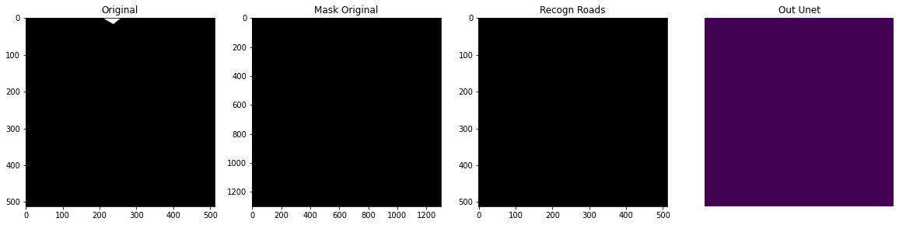
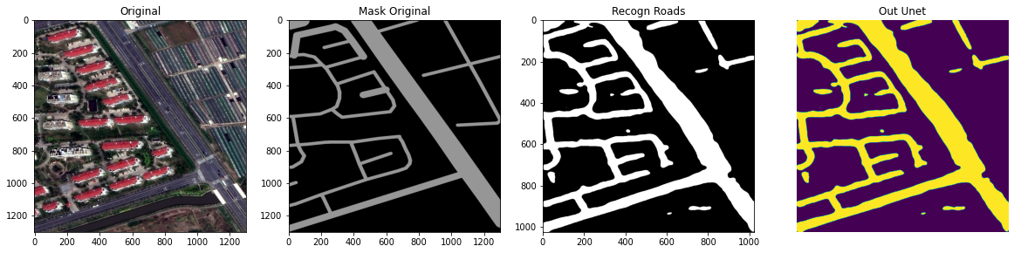
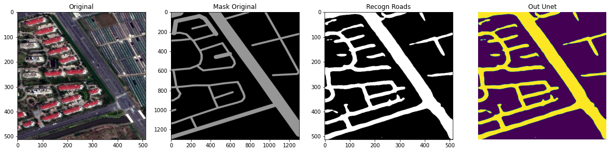
Model 1
Model 2
Image
Original Mask
Prediction
Image
Original Mask
Prediction

Slide 23
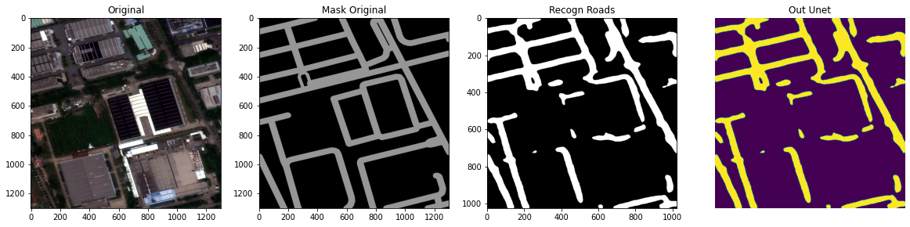
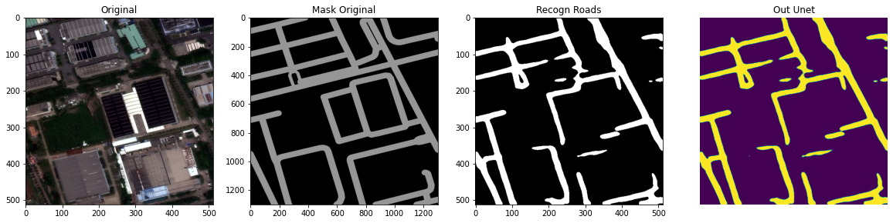
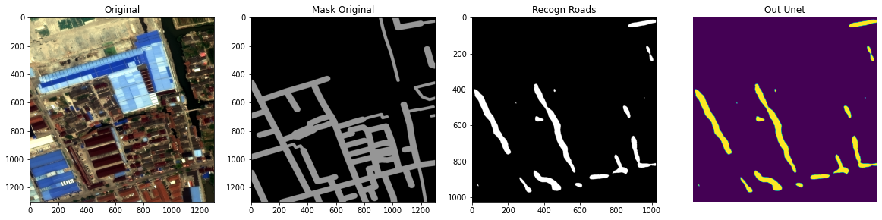
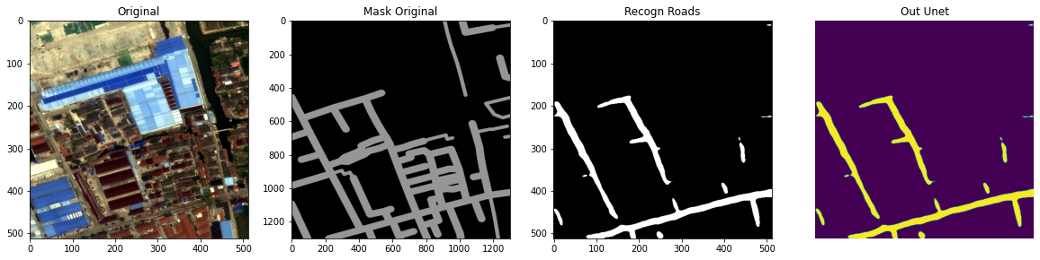
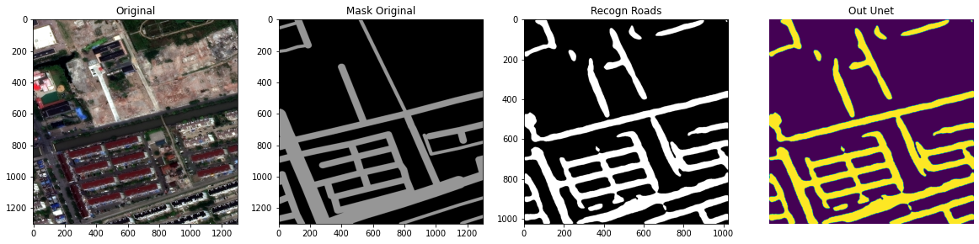
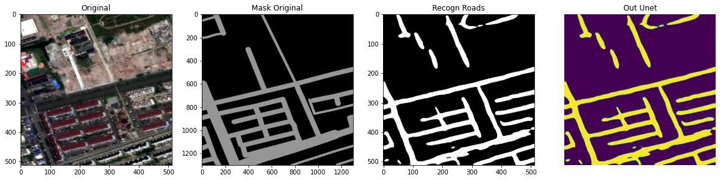
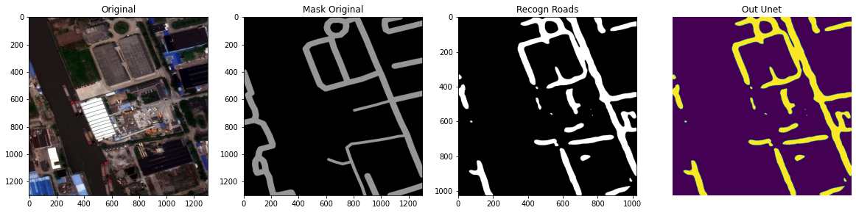
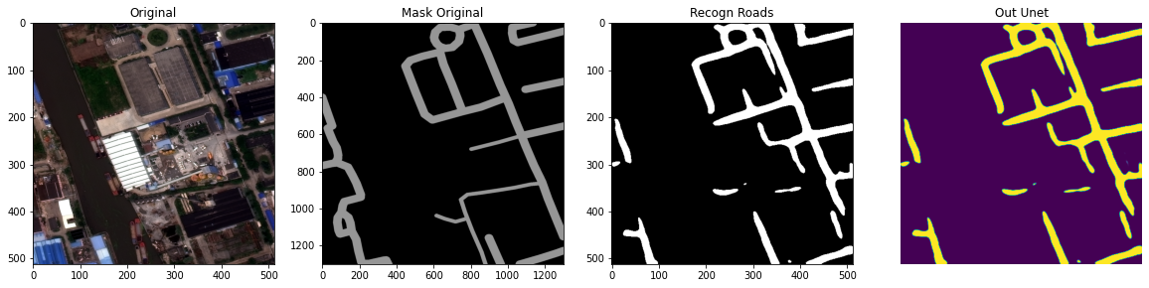
Model 1
Model 2
Image
Original Mask
Prediction
Image
Original Mask
Prediction

Slide 24
Alternatively – Training/Test Set Split
The 1198 8-bit images and their binary masks are split into…
A training set with 1070 images (90%)
A validation set with 59 images (5%)
A test set with 61 images (5%)
Randomly select 120 (1300, 1300) images
Split each of them into 25 (256, 256) images
A training set with 3000 images (95%)
A validation set with 150 images (5%)
A test set with 1525 images
Also split each of them into 25 (256, 256) images

Slide 25
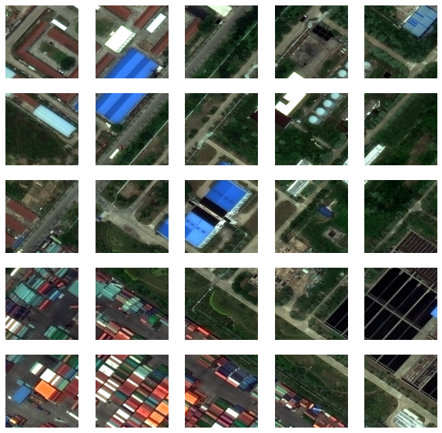
Alternatively – Training/Test Set Split (Example)

Slide 26
Run Models on Split Images
The input of each model is now (256, 256, 3). Other parameters remain the same
Entire Image
F1 score after fitting Model 1
0.6685
F1 score after fitting Model 2
0.6569
Split Image
F1 score after fitting Model 1
0.6269
F1 score after fitting Model 2
0.6292

Slide 27
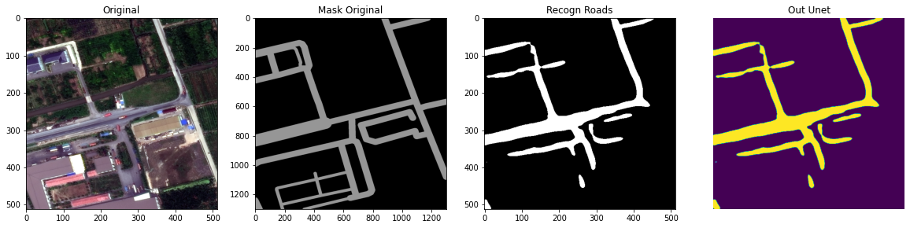
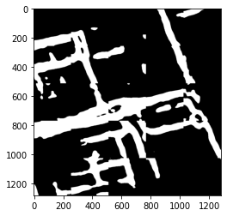
Run Models on Split Images (One Example)
Image 1497
Original Mask
Model 2 Prediction
Using the Whole Image
Concatenation of
Model 2 Prediction
Using Split Images

Slide 28
Future Directions
Both models used in the project are existing architectures. Keep learning about neural networks.
Find a more precise way for buffering the strings.
Think about how the raster result can be effectively transferred to vectors.
How to preserve Connectivity?

Slide 30
Image 73
Image 73 and its label
Image 73 and its binary mask
Image 52
Image 52 and its label
Image 52 and its binary mask

Slide 31
Image 432
Image 432 and its label
Image 432 and its binary mask
Image 435
Image 435 and its label
Image 435 and its binary mask

Slide 32
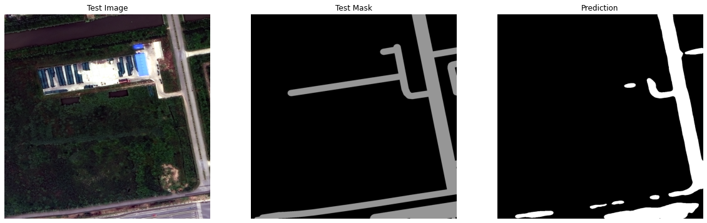
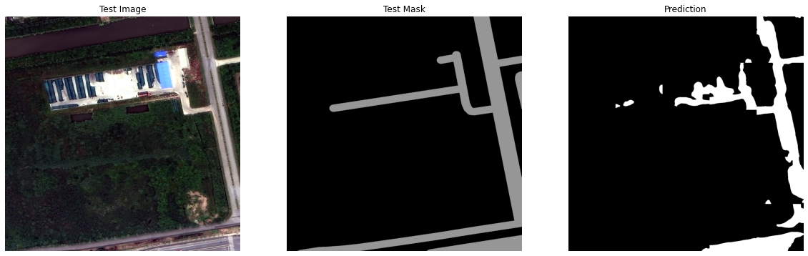
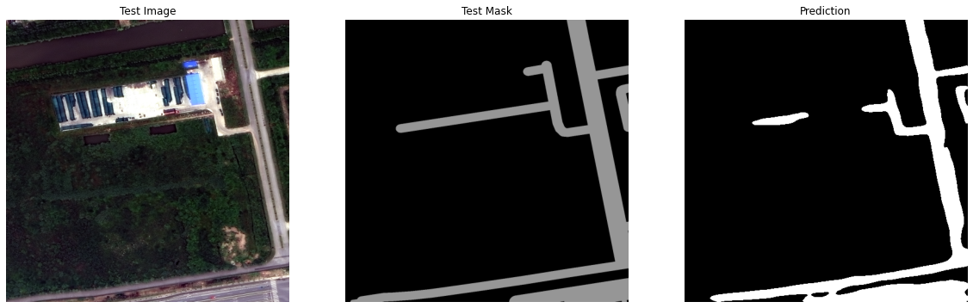
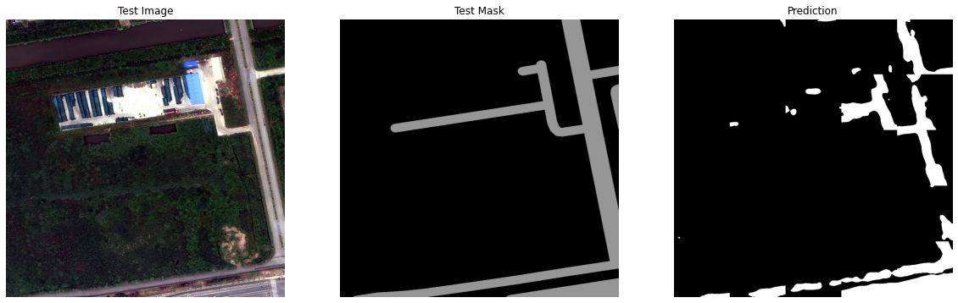
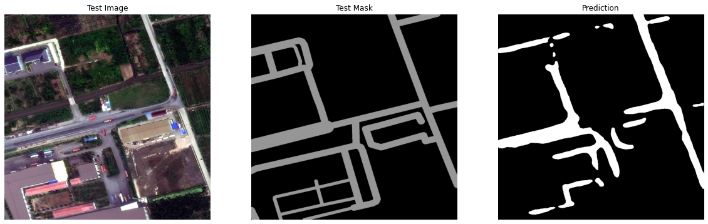
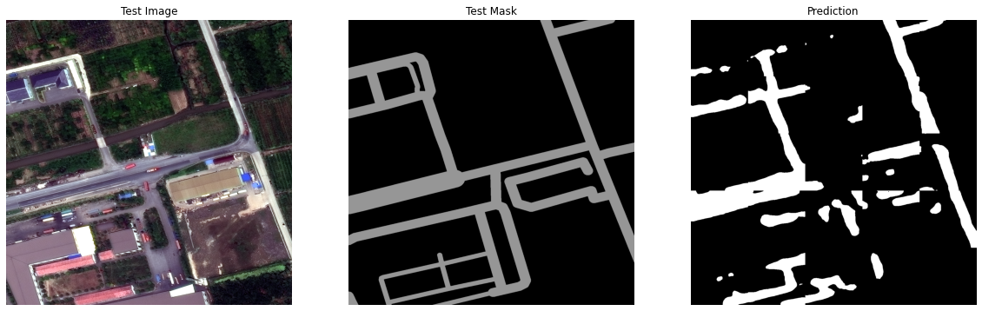
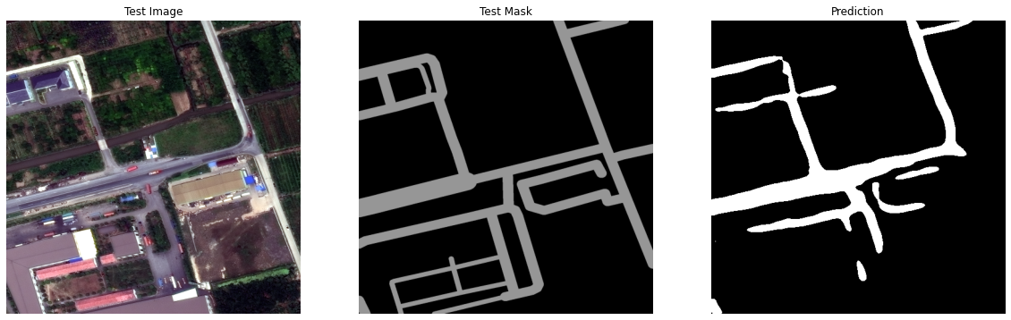
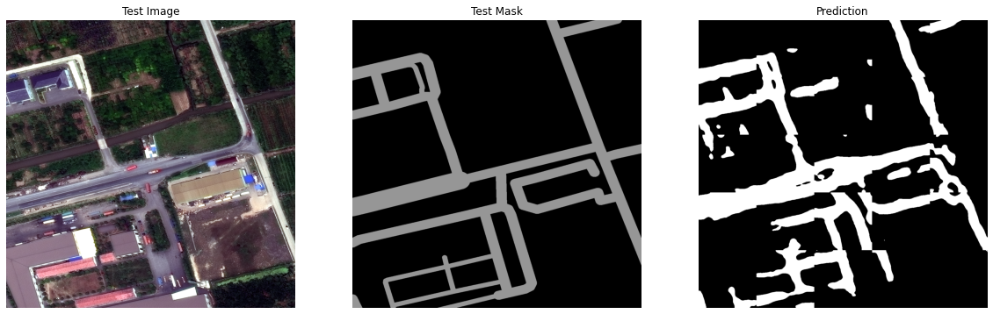
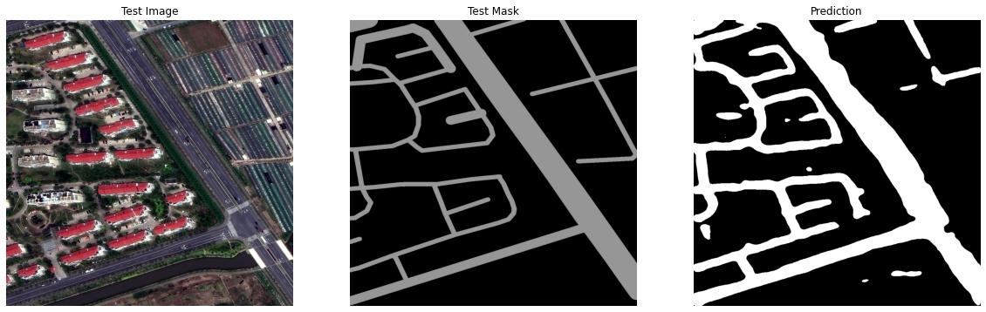







Original Test Image
Original Test Mask
“Vanilla” U-Net Whole Images Prediction
“Vanilla” U-Net Split Images Prediction
ResNet U-Net Whole Images Prediction
ResNet U-Net Split Images Prediction

